Slide 1
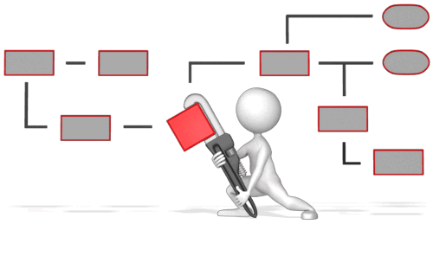
Buildable Digital Health Blueprint
Developing “construction” documents and an investment and implementation roadmap for the national HIE
TWG Kick-off Meeting
[Date]

Slide 2
Overview
Welcome
Introductions
Review of scope and timeline
Overview of the processes
Pre-workshop content
Interactive workshop, including feedback from previous
Summary and meeting closure

Slide 3
Welcome
Please welcome to the podium to kick off our project, the executive sponsor for the national HIE initiative:
Her Excellency Dr. Mosa Khan

Slide 4
Introductions…
Project leaders: Dr. A (MoH), Mrs. B (National Digital Health Agency)
TWG members: Mr. C (WB), Mrs. D (WHO), Dr. E (UNICEF), Mrs. F (NGO-1), Mr. G (NGO-2), Mrs. H (MoF), Dr. J (MoCommunication), Dr. K (National University), Mrs. L (Patient Advocate), Mr. M (NGO-3), Mrs. N (College of Nurses), Ms. P (CHW Rep.), Dr. Q (Lab Tech Rep), Mrs. R (MOH), Mr. S (MOH), Mrs. T (NDHA), Mr. U (NDHA), Dr. V (College of Pharmacists)

Slide 5

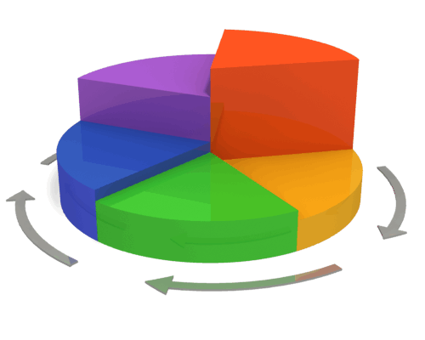
Interaction 0.0
https://forms.gle/MXCn1CZoHsiAGcVZ9
What is your favourite animal as a PET?
During our workshops, we will leverage anonymous forms to collect and collate the information we need to develop our blueprint.

Slide 6
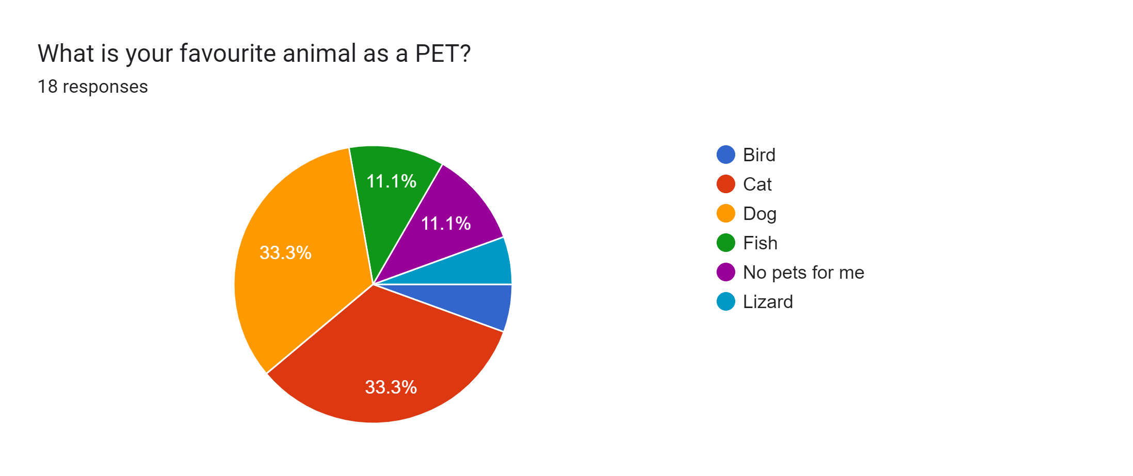
Favourite PETs

Slide 7
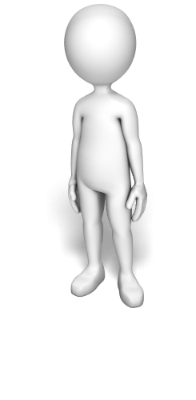
What process will we follow?

Slide 8

A toolkit-supported process will work to align digital health tactics to the digital health strategy and to the MOH’s overall health strategy.
What is the country’s burden of disease?
What is the current health system strategy? (check for alignment to the burden of disease)
What is the current digital health strategy? (check for alignment to the burden of disease and the health strategy)
How can digital health make an impact, and what conformance-testable infrastructure elements are needed?
Where are we now (current state) and what should be done to progress from the current state to the future state?
How will implementation activities drive costs and deliver benefits, and what is the investment rationale for the proposed plan?

Slide 9


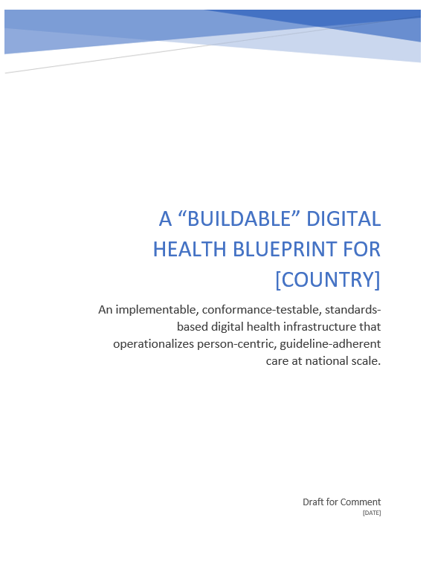



Multiple facilitated workshops will be leveraged to generate relevant content documented in the buildable blueprint.
Upstream
Activities
Research &
Preparation
Background Information
“Homework”
(pre-read materials)
PPT Deck
Questions
For Discussion
Downstream
Activities
Real-time
Questionnaire
Results
Real-time
Questionnaires
Consensus
Content
Workshop
Activities
Blueprint
Document
Discussion

Slide 10











To mitigate risk, the toolkit leverages accepted international norms, standards, and conformance-testable architectural patterns. Data-informed decisions are based on credible global sources.

Slide 11



The investment rationale leverages an activity-based costing approach. Cost-utility analyses (CUA) are used to develop a Dollars-per-DALY forecast over a 10-year implementation planning horizon.
$
Money IN
Health OUT
ROI
time

Slide 12

It is expected that the blueprint will be developed by a multi-stakeholder TWG over a short-duration project.
The TWG will align tactics to existing digital health and health system strategies. An implementable, conformance-testable digital health specification will be developed that is based on the current context.
International best practices will be leveraged wherever possible to mitigate implementation risk.
The investment rationale will develop a Dollars-per-DALY metric over a 10-year planning horizon.

Slide 13
What will be the project outputs?

Slide 14


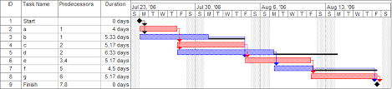









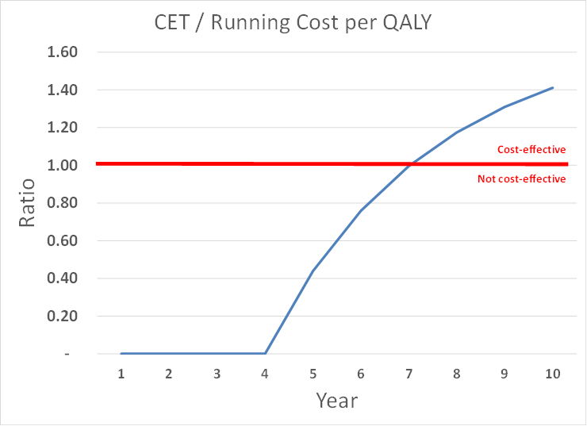

The key project outputs will be a contextual analysis, a conformance-testable, implementable, digital health design specification, and a 10-year investment rationale based on a notional implementation plan.

Slide 15
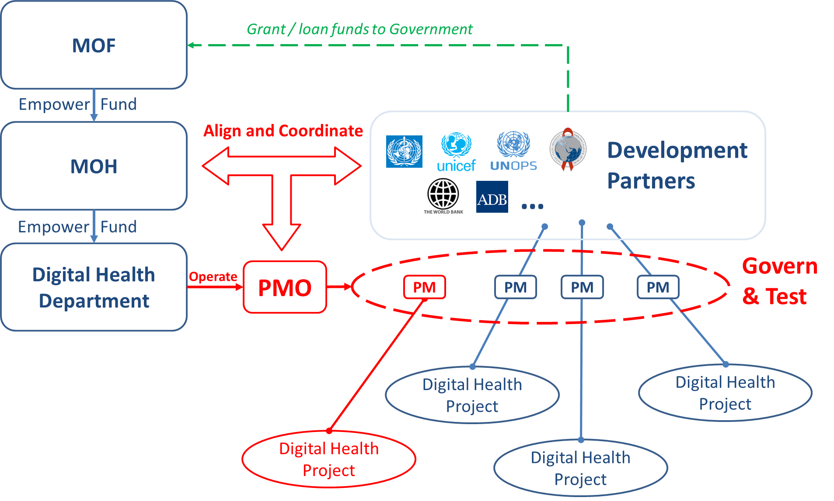
Based on the contextual analysis, recommendations related to governance and relevant legal frameworks (consent, privacy, etc.) will also be documented.

Slide 16
The blueprint document resulting from the toolkit process will include chapters on each of these relevant sections, plus appendices. An example Table of Contents is shown below.
Introduction
National Burden of Disease
National Health & Digital Health Strategies
Components of a “Buildable” Health Information Exchange
Digital Health Landscape and Quick-win Opportunities
Governing the National HIE
Appendix: Example Use Rationale
Appendix: 10-year Roadmap & Associated Investment Rationale

Slide 17
The project outputs will be actionable artefacts.
The contextual analysis will align digital health tactics and designs to current strategies, deployments, and (where applicable) global best practices.
A buildable, conformance-testable, standards-based digital health specification will address contextual requirements.
The notional project plan will map a path from the current state to the desired future state.
The investment rationale will document costs and benefits over a 10-year horizon and support decision-making.
Where appropriate, governance and policy recommendations will be documented that can inform new legislation.

Slide 18
Project Scope
Evaluate context and requirements
Review existing strategies and map the HIE project’s value proposition in supporting these
Develop actionable engineering artefacts
Evaluate “accelerator” opportunities
Evaluate data and programme governance readiness; make recommendations as needed
Develop an implementation and investment plan

Slide 19
Project Timeline
M1
M2
TWG Kick-off
WS-1
WS-2
WS-3
WS-4
Review
Blueprint Draft
Publish
Blueprint

Slide 20
Iterative Process
Prior to the interactive part of each workshop session, background content will be shared. These materials will inform the interactive discussion and help the workshop be more productive.
Each workshop will begin with a review of the real-time feedback collected in the previous workshop(s).
The interactive workshop will leverage anonymous, real-time input captured from attendees during the meeting. These interactive data will inform the discussions and support consensus-based decision-making.

Slide 21
Next steps…
Pre-read materials will be circulated to TWG members; these are to be reviewed prior to Workshop-1
Workshop-1 is scheduled for yyyy-mm-dd at the National University Campus, Building-1, 9:00am (or online via Zoom, link to be shared along with pre-read materials).
Remember – you will need your PC, tablet, or smartphone to fill in the questionnaires.

Slide 22

We are started!

